Slide 1
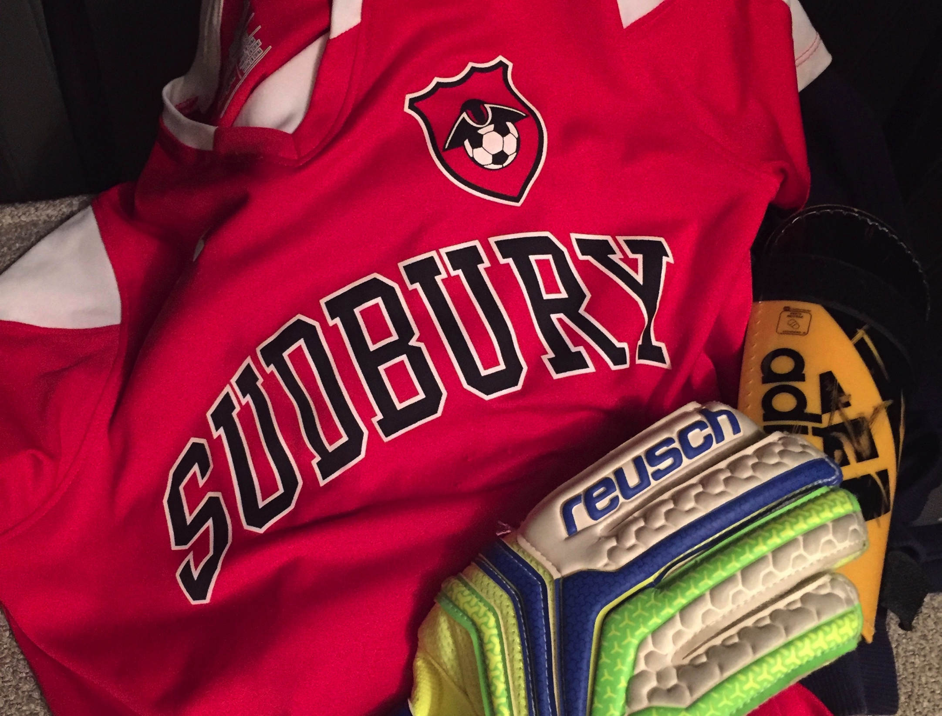
Sudbury Youth Soccer
Player Progression
From Kindergarten to High School, there is a place for all interested soccer players!

Slide 2
U-Little Program The Beginning!
Our youth soccer program starts in the fall of the participants Kindergarten school year! The U-Little teams (K and 1st grade) are separated by boys and girls into teams with volunteer parent coaches leading the way. This program is run and organized in-town by SYSA.
The 8 week program is held on the weekend with a combination training session and small sided game taking place during a 75 minute time slot. Coaches from the NE Revolution Academy will demonstrate a particular skill each week to all the teams and then the coaches will further show the players the new skill in their smaller groups. A fun small sided game will follow!
At this age, our focus is to create a positive and fun atmosphere where players can learn and develop at their own pace, improve the basic motor skills that are used in soccer, help to create players that are comfortable with the ball at their feet and to give each player a positive and successful experience each season!

Slide 3
2nd Grade Program More Training!
In the Second Grade, players will begin to practice one day a week and play games each weekend!
The program will run for 10 weeks and will be coached once again by parent volunteers.
Coaches from the NE Revolution Academy will demonstrate a particular skill each week during the grade level practice to all the teams and then the coaches will further show the players the new skill in their smaller groups. A fun small sided (4 v 4) game will follow!
At this age, our focus is to help each player reach their full potential in the sport of soccer, improve each player’s knowledge and understanding of the game and to instill the importance of learning how to win and lose graciously and the full meaning of fair play.

Slide 4
3rd Grade to HS Program Travel Games!
In the 3rd through HS grades, players will begin to practice two days a week and begin play games against other local towns! The teams are SYSA organized but played in the BAYS (Boston Area Youth Soccer) leagues. The program will run for 10 weeks with 2 training sessions and 1 game per week. Teams will be coached once again by parent volunteers.
Beginning in 3rd grade, teams will be created based on the soccer skills and techniques of the player. The constructed team will then be grouped with similar level teams for their weekly games. During these age groups, the range of personal and skill growth can become evident and players playing in the right place is important.
Each grade-wide practice session (Group Night) will be run by coaches following the particular weeks NE Revolution Academy Skills Program. Skills will then be displayed and practiced during the training portion of the session and the small-sided game that will conclude each practice. Team specific practices are run by the coaches and usually focus on skills that need improvement on the particular team.

Slide 5
Skills Development Academy Perfecting Your Touches!
In the 2nd through 8th grades, players will be given the opportunity to participate in the optional Skills Development Academy. The program will run for 10 weeks with 1 training session per week. Sessions will be coached by NE Revolution Academy Coaches.
The Skills Academy Development League is a 7-week program. Players are divided into mixed ability teams for the entire session. They will train for the 40 minutes and then will play a 30-minute game (5 minute half time) against another Skills Academy Development team. All teams will get a consistent, professional Revolution Staff Coach for the season.
This program in essence is taking the success of the Skills Academy and the competitiveness of the Futsal League and blending them together to create a fun, positive, player-centric, in town program.

Slide 6
The Academy Squads Developing Players Our Way!
The Sudbury Youth Soccer Association (SYSA) Academy is an advanced travel soccer program that is based in Sudbury for Sudbury 5th to 8th graders. Teams are coached by professional coaches from the New England Revolution Academy. The program is roughly half the cost of other professionally coached programs.
The Academy provides each squad with dedicated professional New England Revolution Academy staff that teach a cutting edge, continuous, progressive, professional curriculum designed to develop the individual player at each age level in a positive and creative environment.
Unlike other programs that play only the best players, are focused solely on winning games, the team’s record and the club’s reputation, the Academy is a player-centric program that is focused on developing young players to reach the next level. We do this by providing a “toolkit” – consisting of skills, tactical awareness and mental focus – the necessary components for success at the highest level each player can achieve.

